Slide 1













ESG & BEYOND: ADAPTING TO THE NEW GLOBAL SUSTAINABILITY LANDSCAPE
HELPING TRADERS TO KEEP ON TRADING
8TH MAY 2025
12:00-13:00
An initiative brought to you by selected Chambers of Commerce across the UK

Slide 2

AGENDA
Welcome Words & Brief Intro to Chambers Trade Academy
ESG & Beyond: Adapting to the New Global Sustainability Landscape, Andrea Collins, MD GTD
3. Q&A
4. Closing Remarks

Slide 3

  ABOUT THE CHAMBERS TRADE ACADEMY

Slide 4


  ABOUT THE CHAMBERS TRADE ACADEMY
An initiative of selected Chambers of Commerce across the UK to provide free virtual sessions covering the basics of exporting and importing, briefings on latest regulations as well as opportunities to go global.
Combined we represent more than 18,000 member businesses of all sizes and sectors.

Slide 5

  INTERNATIONAL TRADE SUPPORT
We support traders of all sizes and sectors and provide services for every stage of your internationalisation journey.
International Trade Events
Readiness Assessment
Export, Import & Customs Training Courses
Customs & Regulatory Consultancy Services
Market Identification Services
Market Research and Entry Services
Partner Finding Services
Commercial Debt Recovery
Foreign Exchange Services
Letters of Credit Preparation Services
Credit Checks
Certification, Legalisation and Apostille Services
Customs Brokerage Services

Slide 6

2. ESG & BEYOND: ADAPTING TO THE NEW GLOBAL SUSTAINABILITY LANDSCAPE
ANDREA COLLINS
MD, GLOBAL TRADE DEPARMENT

Slide 7

WHAT WE COVER TODAY
Sustainability regulation globally
Categories of sustainability regulation
  Eco design; Circular economy; Waste; Chemicals; Plastics
  Carbon neutral and net zero goals
  Due diligence and Reporting
  Greenwashing
  Forestry and Eco systems
  Global Green Taxonomies
Deep Dive:
  EU Packaging and Packaging Waste Regulation (EU PPWR)
  EU Eco-design for Sustainable Products Regulation (EU ESPR)
  EU Carbon Border Adjustment Mechanism (EU CBAM)
  EU Corporate Sustainability Reporting
Practical steps towards regulatory compliance
Benefits to SMEs of voluntary regulatory compliance

Slide 8
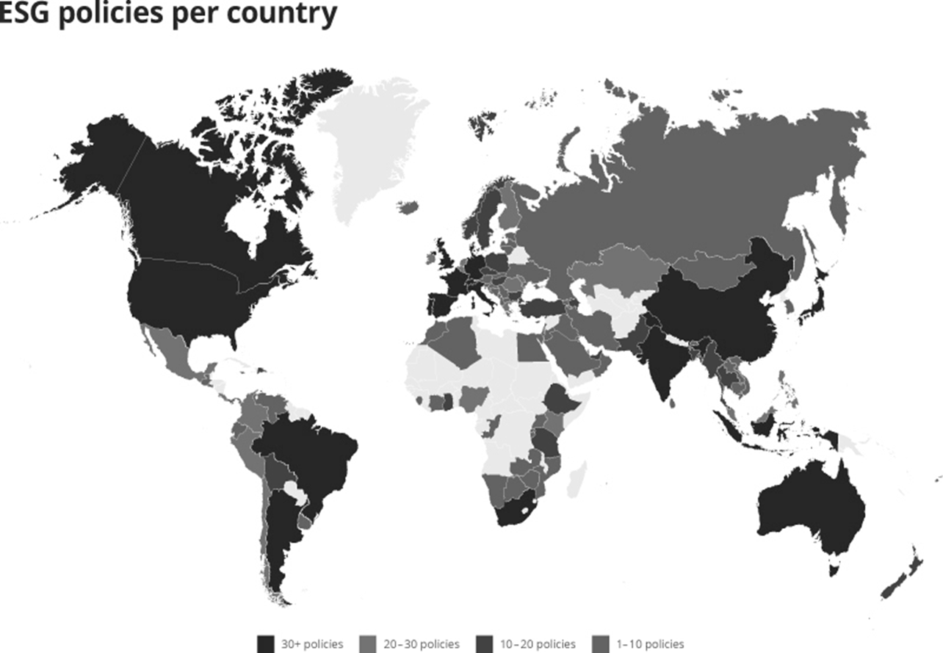
SUSTAINABILITY REGULATION GLOBALLY
ESG Policies globally:
European Union
Australia
United States
Canada
Brazil
Argentina
South Africa
China
India
Indonesia
Japan

Slide 9
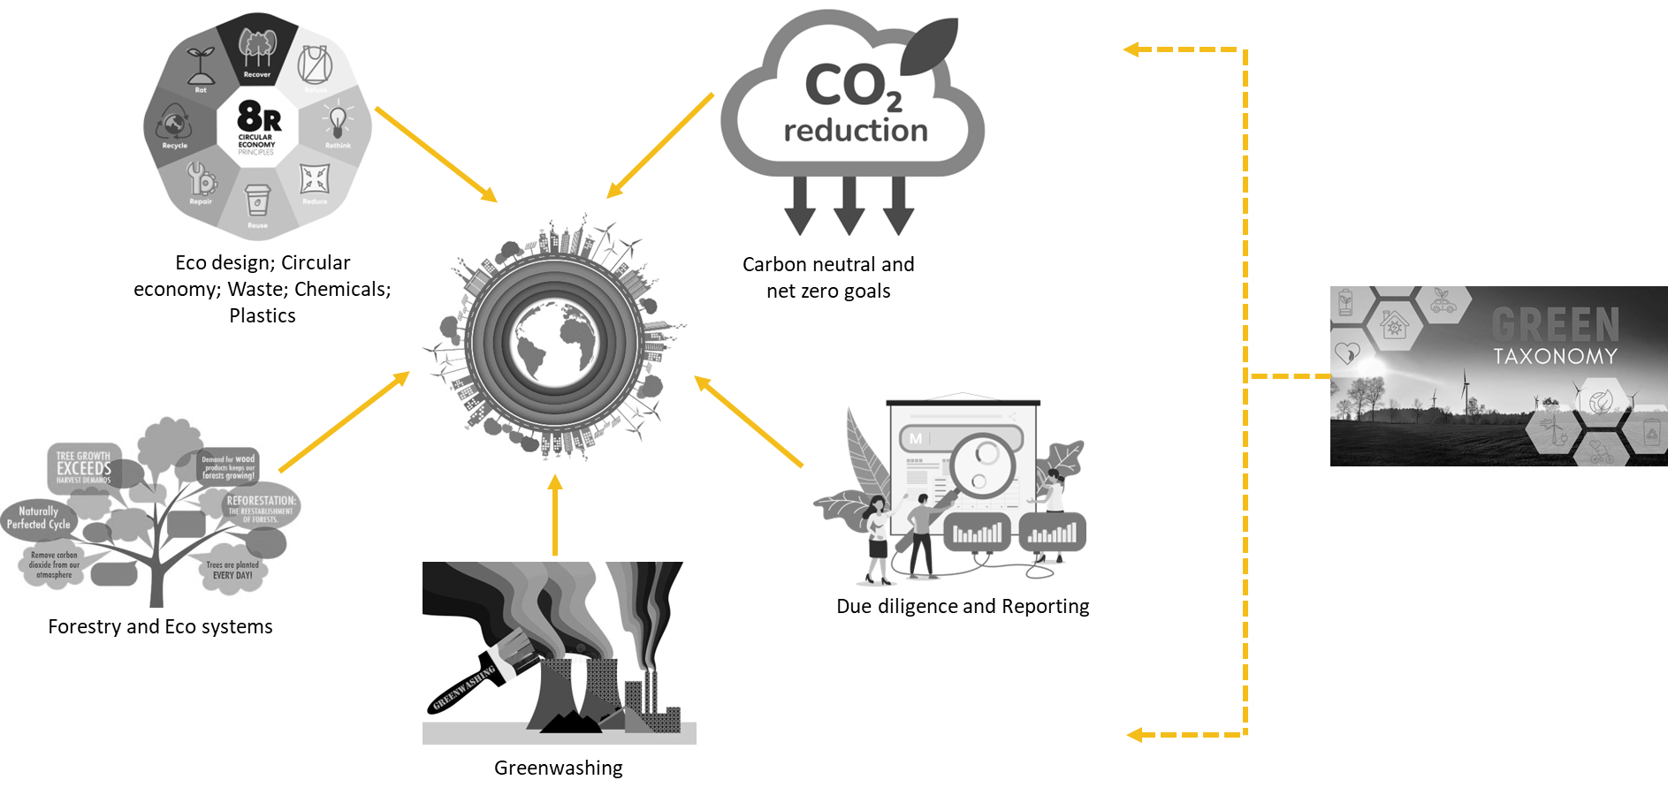
CATEGORIES OF SUSTAINABILITY REGULATION

Slide 10
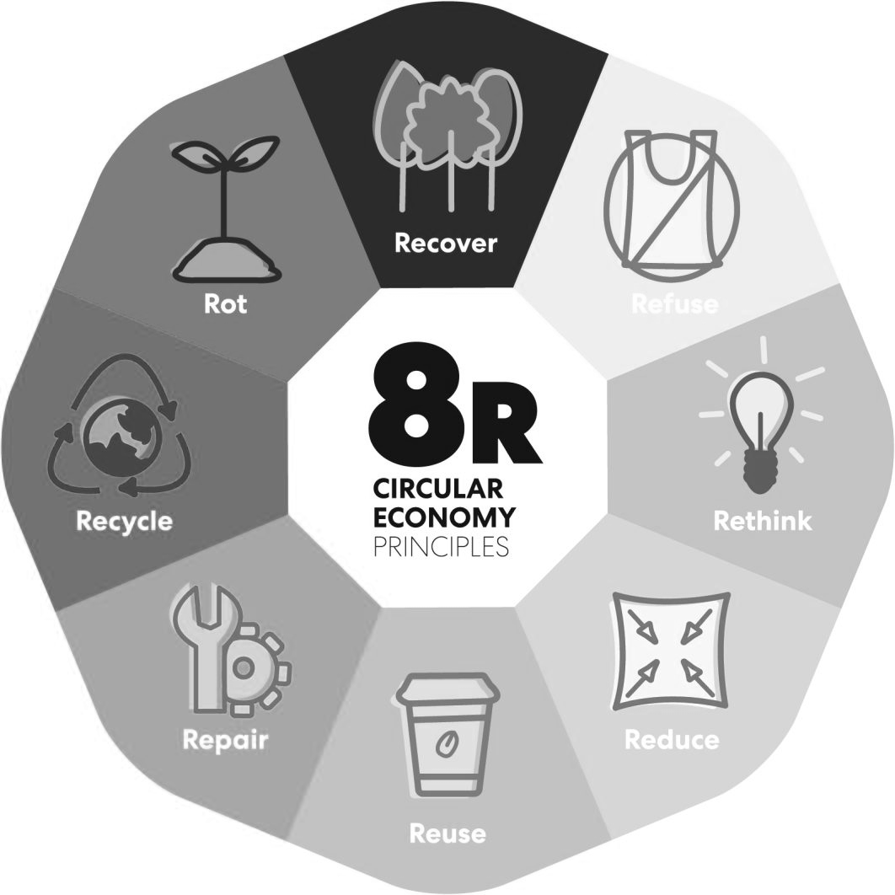
ECO DESIGN; CIRCULAR ECONOMY; WASTE; CHEMICALS; PLASTICS
Eco-design goes hand in hand with the circular lifecycle. It tries to avoid designing products that get discarded after only one use and have no further benefit after their end of life.
In the ideal circular lifecycle, the end of life of products is considered the start of a new one, while the product’s entire lifecycle and its further uses were already considered during their creation.
Effective waste management plays a crucial role in supporting sustainable development and the transition towards circular economy.
Chemical waste, like other hazardous waste needs to be treated, disposed of, or recycled, safely.
Reducing use of plastic globally is imperative as it remains in the environment, threatening wildlife, spreading toxins, and contributing to global warming.
Circular economy interventions in four key sectors (agriculture, construction, textiles and forestry) can help the world’s biodiversity recover to YR2000 levels by 2035
UK has a "Circularity Gap" of 92.5%; vast majority of material inputs to the UK economy come from virgin sources
EU has a circularity rate of 11.8% (2023)

Slide 11
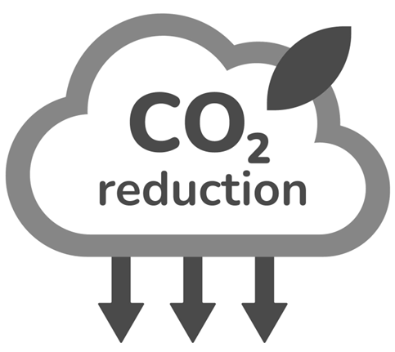
CARBON NEUTRAL AND NET ZERO GOALS
Carbon regulations exist to mitigate climate change by reducing greenhouse gas (GHG) emissions, primarily carbon dioxide (CO2), but also methane (CH4), nitrous oxide (N2O), and other hydrofluorocarbons
  Carbon neutral vs. Net zero: net zero means to goes beyond the removal of all GHG, not just carbon
  107 countries, responsible for approximately 82% of global greenhouse gas emissions, had adopted net-zero pledges (source: UN, Jun 2024)
Asia is the largest regional emitter of greenhouse gases, accounting for approx. 50% global emissions, with China as the largest emitter globally. North America and Europe follow, while Africa and South America are smaller emitters.
UK’s greenhouse gas emissions were 53% lower in 2023 than in 1990
EU’s net greenhouse gas emissions were 37% lower in 2023 than in 1990
EU has a circularity rate of 11.8% (2023)

Slide 12

DUE DILIGENCE AND REPORTING
Sustainability due diligence is a process used to assess and manage environmental and social impacts of supply chains, to identify, prevent, and mitigate potential risks i.e. identify and address negative environmental and human rights impacts.
Sustainability reporting is a form of non-financial reporting that conveys a company’s progress toward goals around ESG parameters, as well as identifying current and future risks and impacts. The shift is moving from voluntary disclosures to mandatory requirements in many jurisdictions.
96% of the world’s largest companies report on sustainability
95% of the world’s largest companies publish a carbon target
Real pressure on SMEs to produce sustainability reports coming from larger entities looking to meet the European Sustainability Reporting Standards (ESRS)
More than 80% of SMEs recognise sustainability as a substantive issue
Only 7.7% of SMEs currently run formal sustainability reporting programmes

Slide 13
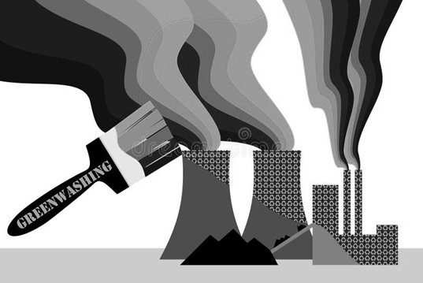
GREENWASHING
Refers to false or misleading statements made about the environmental performance or impact of a business, product, or service. Examples:
  Generic ‘green’ claims and ‘buzzwords’
  Claims of ‘net zero’ and ‘carbon neutral’
  Unsubstantiated ‘eco-friendly’ statements
  Broad or ambiguous environmental commitments
6 types: Greencrowding; Greenlighting; Greenshifting; Greenlabelling; Greenrinsing; Greenhushing [source: Planet Tracker]
Legislation will force companies to substantiate claims
Greenwashing is the 2nd most concerning issue for environmentally conscious consumers
72% of North American companies admit to greenwashing
As many as 95% of products on the EU market claiming to be “green” contain some form of greenwashing.
Almost half of packaging sold as “biodegradable” in the EU does not meet industry standards
Globally, 58% of companies admit to greenwashing

Slide 14
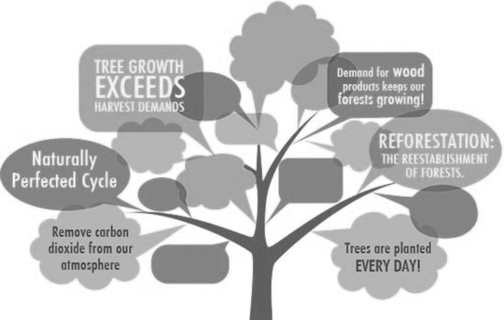
FORESTRY AND ECO SYSTEMS
Legal and policy frameworks designed to manage forest practices in a way that protects the environment and biodiversity
Key aspects: Biodiversity conservation; Sustainable harvesting; Carbon sequestration; Water quality protection; Land use planning
Example regulation: EU's new Deforestation Regulation impacts cattle, cocoa, coffee, oil palm, rubber, soya and wood, and their derivatives
Sustainable forestry means managing forests in a way that will keep forests healthy and usable for local communities and society as a whole for generations to come
COP26 (2021) - Global leaders committed to ending and reversing deforestation by 2030
Kunming-Montreal Global Biodiversity Framework (2023) pledged to eliminate the destruction of biodiverse areas and ensure that min. 30% of degraded ecosystems are restored by 2030
IMPORTANT: Halfway through decade, deforestation globally is NOT slowing down

Slide 15
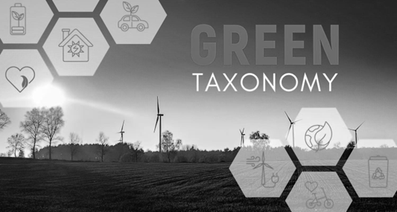
GLOBAL GREEN TAXONOMIES
Classify investments based on their environmental impact and sustainability. Purpose:
  Creates a frame of reference for investors and companies
  Supports companies in their efforts to plan and finance their transition
  Protects against greenwashing practices
  Helps accelerate financing of those projects that are already sustainable and those needed in the transition
Example: EU Taxonomy. Has 4 overarching conditions that an economic activity must meet to qualify as environmentally sustainable:
  Making a substantial contribution to at least one environmental objective
  Doing no significant harm to any of the other five environmental objectives
  Complying with minimum safeguards
  Complying with the technical screening criteria set out in the Taxonomy delegated acts
Green taxonomies serve two primary purposes: 1) promote market integrity, consumer protection, and avoid greenwashing; and 2) help mobilise capital towards the green economy by supporting investors to identify and value green assets
€191 billion in capital investments aligned with the EU Taxonomy (2023)

Slide 16
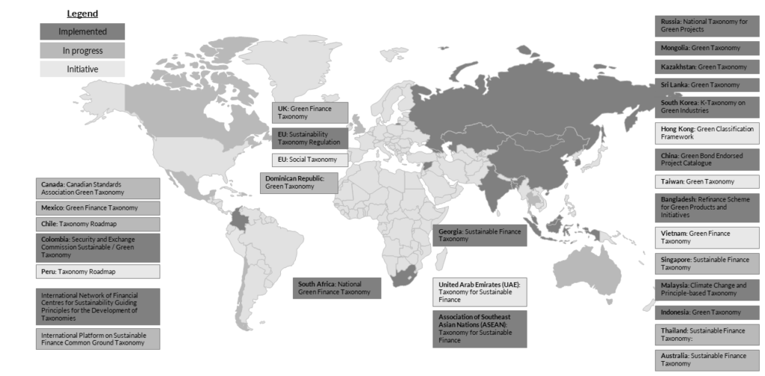
GREEN TAXONOMIES GLOBALLY

Slide 17
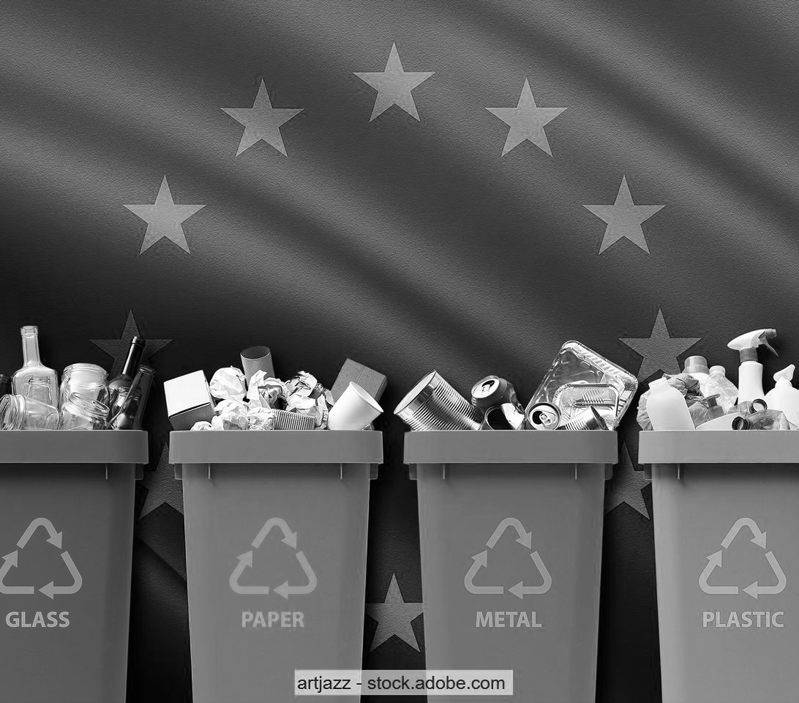
DEEP DIVE: EU PPWR
EU PPWR (Packaging and Packaging Waste Regulation) aims to reduce environmental impact of packaging and packaging waste e.g. main purpose creating a circular economy for packaging materials, ensuring that packaging is designed to be recyclable, reusable, and reduces waste generation.
Main objectives:
  Waste reduction
  Improved recyclability
  Encouraging reuse
  Reduction of Single-Use Plastics
  Extended Producer Responsibility (EPR)
  Harmonisation across the EU
Notable points:
Restrictions on certain single-use plastics (pre-packed fruit and veg weighing less than 1.5 kg and individual portions of condiments, sauces, and sugar in hotels, bars and restaurants)
Minimising the weight and volume of packaging and avoiding unnecessary packaging
2030 and 2040 targets for a minimum percentage of recycled content in packaging
Take-away businesses to offer customers option to bring their own containers at no extra cost.
Minimising substances of concern, inc. restrictions on packaging containing per- and polyfluorinated alkyl substances (PFAS)
11th February 2025
PPWR enters into force
30th November 2022
Commission adopted regulation
12th August 2026
End of transitional period

Slide 18

DEEP DIVE: EU ESPR
EU ESPR (Ecodesign for Sustainable Products Regulation) aims to promote sustainability in the design, production, and use of products sold in the EU. Part of EU's broader strategy for achieving a circular economy and reducing environmental impacts throughout a product's lifecycle.
Main objectives:
  Improve product sustainability
  Circular economy
  Reduction of environmental impacts
  Boosting green innovation
  Consumer empowerment
  Harmonisation across the EU
Eco-design requirements:
Improving product durability, reusability, upgradability and reparability
Enhancing the possibility of product maintenance and refurbishment
Making products more energy and resource-efficient
Addressing the presence of substances that inhibit circularity
Increasing recycled content
Making products easier to remanufacture and recycle
Setting rules on carbon and environmental footprints
Limiting the generation of waste
Improving the availability of information on product sustainability
5th December 2023
Provisional agreement on more sustainable, repairable and circular products
Q2 2025
Adoption and publication of first ESPR working Plan
11th December 2019
Adoption European Green Deal
18th July 2024
New Eco-design for Sustainable Products Regulation enters into force

Slide 19

DEEP DIVE: EU CBAM
EU CBAM (Carbon Border Adjustment Mechanism) aims to prevent "carbon leakage" and incentivise climate action globally. Key component of the European Green Deal, ensuring EU industries remain competitive while the EU works to reduce its carbon emissions.
Main objectives:
  Prevent carbon leakage
  Incentivise global climate action
  Support the EU’s Green Deal
  Level the playing field
  Encourage greener production practices
Initial scope (45% of EU ETS sectors):
Iron and steel; Cement. Fertilisers; Aluminium; Hydrogen; Electricity
Future scope (100% of EU ETS sectors):
CO₂: Heat generation; Oil refineries; Metals; Lime; Glass; Ceramics; Pulp; Paper; Cardboard; Acids; Bulk organic chemicals; Aviation; Maritime
Nitrous oxide (N₂O): Production of nitric, adipic and glyoxylic acids and glyoxal
Perfluorocarbons (PFCs): Production of aluminium
31st January 2024
First reporting period for importers
1st January 2026
‘Authorised CBAM declarant’ status becomes mandatory
1st October 2023
Beginning of transitional phase
1st January 2025
Access to CBAM Registry for non-EU installation operators

Slide 20

DEEP DIVE: EU CORPORATE SUSTAINABILITY REPORTING (EU CSRD)
EU CSRD (Corporate Sustainability Reporting Directive) aims to improve and standardise sustainability reporting across companies operating in the EU, enabling stakeholders (i.e. investors, consumers, regulators, etc.) to make informed decisions regarding the environmental, social, and governance (ESG) practices of companies.
Main objectives:
  Improve transparency and accountability
  Standardise sustainability reporting
  Support the EU’s Green Transition
  Encourage long-term value creation
  Enable better decision-making
Align with global standards
Scope EU companies:
2025 – Largest companies 500+ employees (reporting YR 2024)
2026 – Large companies 250+ employees / €25m assets (reporting YR 2025)
2027 – SMEs 10+ employees / €0.9m assets (reporting YR 2026)
Scope non-EU companies:
Net EU turnover of €150m and one of the following:
  Large EU subsidiary (meeting the EU company criteria above)
  Branch in the EU with net turnover >€40m
  Securities listed on EU regulated markets
31st July 2023
Adoption of the European Sustainability Reporting Standards (ESRS)
2025
First reports published on 2024 financial year
5th January 2023
Directive entered into force
7th August 2024
Detailed guidance and FAQs published

Slide 21
PRACTICAL STEPS TOWARDS REGULATORY COMPLIANCE
Assess current state (start measuring)
Involve stakeholders (validate internal perceptions of priorities)
Set clear goals and targets (focus on few but do well)
Define specific, measurable, and achievable sustainability goals
Integrate sustainability into company strategy and brand
Reduce energy consumption
Implement energy-efficient practices
Minimise waste
Optimise and vet supply chain
Promote sustainable transportation
Invest in green infrastructure
Educate and engage employees
Communicate sustainability priorities and efforts
Share sustainability goals, progress, and achievements with stakeholders
Considerations:
What sustainability regulation is in force in destination market?
Does it apply to the company (company size, sector, turnover, volume of exports, etc.)
Where company is in scope of regulation, what are its obligations?
What compliance achieved in another market can be leveraged to facilitate compliance in new market?

Slide 22

BENEFITS TO SMES OF VOLUNTARY REGULATORY COMPLIANCE
Competitive advantage
Compliant SMEs make attractive partners for corporate counterparts for whom compliance is mandatory
Attract more eco-aware customers (business and consumer)
Employee engagement and customer advocacy
Improved planning preventing excess inventory and overproduction
Reduced waste
Cost reduction
Enhanced brand reputation and value
Belts and braces approach to sustainability
Increased ease of market access
Potential for greater market share
Improved stakeholder relationships and engagement
Effective risk management and emergency planning
Improvements in innovation and collaboration among teams
Increased access to grant funding and finance
Investment attractiveness

Slide 23
3. Q&A SESSION

Slide 24
4. CLOSING REMARKS

Slide 25
THANK YOU FOR YOUR ATTENTION
We are here to support traders to keep on trading!

