Slide 1


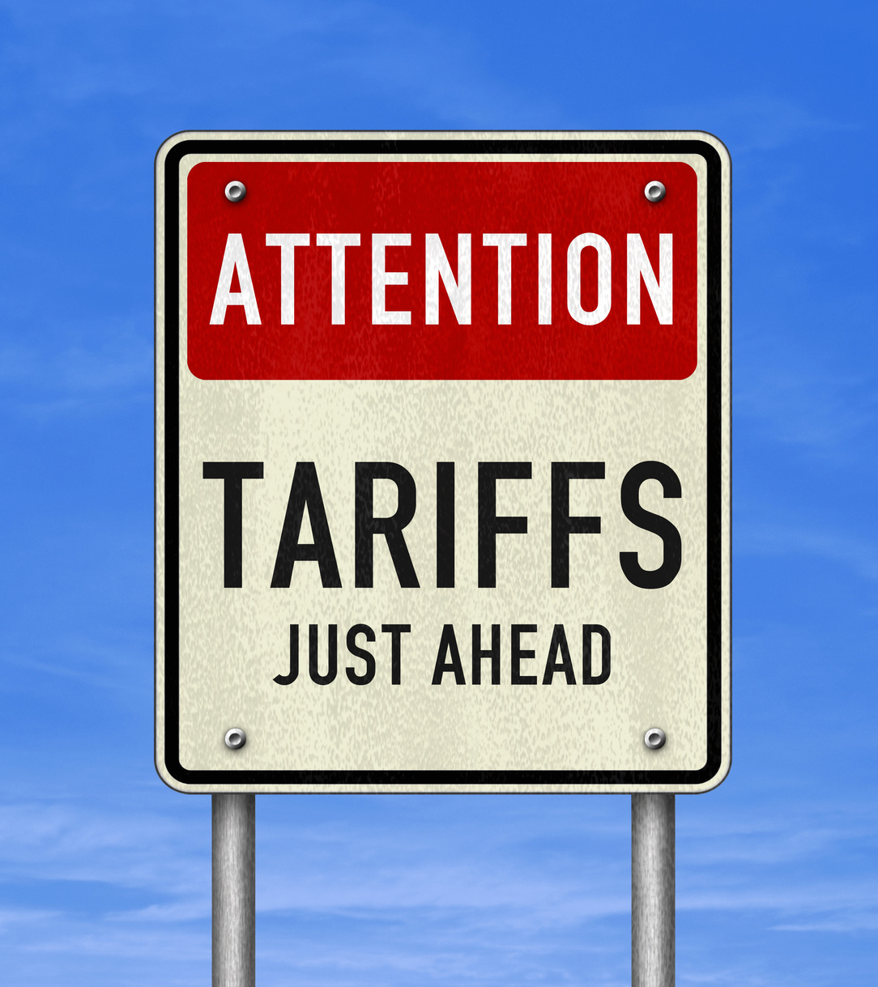













US TARIFFS AND IMPACT ON UK TRADE
ASSESSING IMPACT, MANAGING UNCERTAINTY
24th APRIL 2025
12:00-13:00 UK TIME VIA ZOOM
An initiative brought to you by selected Chambers of Commerce across the UK
Supported by

Slide 2

AGENDA
1. Welcome Words & Brief Intro to Chambers Trade Academy
US Tariffs and Global Trade, William Bain, Head of Trade Policy at BCC
Q&A Panel - Assessing Impact & Managing Risks
4. Upcoming Sessions
5. Closing Remarks

Slide 3

  ABOUT THE CHAMBERS TRADE ACADEMY

Slide 4


  ABOUT THE CHAMBERS TRADE ACADEMY
An initiative of selected Chambers of Commerce across the UK to provide free virtual sessions covering the basics of exporting and importing, briefings on latest regulations as well as opportunities to go global.
Combined we represent more than 18,000 member businesses of all sizes and sectors.

Slide 5

  INTERNATIONAL TRADE SUPPORT
We support traders of all sizes and sectors and provide services for every stage of your internationalisation journey.6
International Trade Events
Readiness Assessment
Export, Import & Customs Training Courses
Customs & Regulatory Consultancy Services
Market Identification Services
Market Research and Entry Services
Partner Finding Services
Commercial Debt Recovery
Foreign Exchange Services
Letters of Credit Preparation Services
Credit Checks
Certification, Legalisation and Apostille Services
Customs Brokerage Services

Slide 6

POLL

Slide 7


2. US TARIFFS AND THE GLOBAL ECONOMY
WILLIAM BAIN, HEAD OF TRADE POLICY
BRITISH CHAMBERS OF COMMMERCE

Slide 8

US TARIFFS TIMELINE
12 March – 25% import duties on UK and global steel, aluminium and derivative products entering the US. Applies to wide range of products from furniture, construction, tableware, nuts, screws. Already having effect on supply chains.
2 April – reciprocal tariffs announced (see next section)
3 April – 25% additional import duties on UK and global automotive vehicles entering the US. This is on top of previous duties of 2.5%, making duty payable at new rate of 27.5%.
5 April – 10% additional import duties on affected products took effect (global baseline rate)
9 April – US reciprocal tariffs on 50 countries above 10% global baseline came into effect but were suspended on the same day for 90 days for non-retaliating countries. For China, the increase in duty was raised to 145%. EU Ministers voted on first sets of retaliatory tariffs on steel and aluminium

Slide 9
US TARIFFS TIMELINE
11 April – China 125% retaliatory tariffs on all US goods imports came into effect.
11 April – US exempts smartphones, flatscreen TVs, solar cells, flash drives, memory cards, solid state data drives from scope of reciprocal tariff (10% Global baseline tariff rise, and 145% additional duties on Chinese goods).
15 April – First set of EU retaliatory tariffs was due to take effect but is suspended until 14 July.
17 April – Decision from US Trade Representative Office on shipping landing charges – stepped back from new charges of $1.5m per landing for shipping lines at US ports which have China made boats in their fleets or on order. New plans exempt non-China made boats. Will impact on logistics around exports.
3 May – 25% duties to apply to automotive parts imported for use in US-made vehicles (estimated $460bn of cars and car parts covered by new duties) – engines, lithium batteries, tyres, shock absorbers, computers.
8 July – 90-day suspension period for non-retaliating countries of reciprocal tariffs above global baseline rate of 10% due to end.
22 November – deadline for report on copper tariffs to go to President.

Slide 10
US TARIFFS: THE NEW PLAN
10% global baseline tariff on all imports applied from 5 April.
Beyond the baseline, differential tariffs country by country represent biggest shift in global goods trade since 1947. Tension with WTO rules.
Pharmaceuticals, semiconductors, lumber, copper, energy, critical minerals, steel, aluminium excluded. From 11 April smartphones, computers and devices, flatscreen TVs, solar cells, memory drives, solid state storage drives exempt from the new tariffs.
May be further sectoral tariffs announced eventually on pharmaceutical, semiconductors and critical minerals.
Duties not stacked – so no supplement on steel/aluminium/automotive tariffs.
9 April – further reciprocal duties applied if tariff assessment made beyond 10% for individual states, but have been suspended for 90 days for non-retaliating countries.
These duties are not cumulative with the sectoral tariffs announced.
China is the exception – it now faces additional duties since start of 2025 of 145% as at 10 April.

Slide 11
US TARIFFS: THE NEW PLAN
How the US Government did the assessment for each country – focus on trade balances in goods.
Reciprocal tariffs meant to examine line by line tariff, regulatory, fiscal issues in each trading market.
Final plan applied a formula focused on goods trade surpluses between the US and trading partners.
UK and Brazil both given 10% reciprocal tariff (the baseline) – average UK duties 1.3%, Brazil 13.29%
Examples of country assessments for tariffs applied from 9 April (suspended for 90 days for non-retaliating states) –
Vietnam 46%, Thailand 36%
China 34% (now up to an additional 125%), Taiwan 32%, South Africa 30%
Switzerland 31%, India 26%, South Korea 25%
Japan 24%, EU 20%
UK, Brazil 10% (baseline)

Slide 12
US TARIFFS: THE NEW PLAN
De minimis threshold ($800) abolished on China and Hong Kong origin goods entering the US – takes effect from 2 May.
Duties will be enforced on low value consignments arriving containing goods of China origin either by sea or international postal services..
Goods sent by post from China or Hong Kong will face ad valorem duties of 120% of the value of the postal package, or a specific duty per item of $100 from 2 May until 31 May, rising to $200 per item from 1 June.
Awaiting definitive guidance from US Customs and Border Protection on enforcement post 2 May.
Threshold stays in place for now on other countries low value consignments but could be reviewed once revenue collection processes fully evaluated by US Administration.
If countries reduce their trade imbalances or produce plans to achieve that, reciprocal tariffs can be adjusted downwards by the President.
If countries adopt further retaliatory measures, their reciprocal tariffs can be adjusted upwards by the President – see potential changes in tariff rates to be applied to China imports.

Slide 13
US TARIFFS: WORKED EXAMPLE ON CHINA-ORIGIN GOODS
For general goods:
On 4 Feb, 10% additional duties were added to duties on China origin goods.
then on 4 March, a further 10% additional duties were applied on China goods.
Then on 5 April a further 10% duties from the US global baseline tariff were added to China goods under the Executive Order of 2 April
Reciprocal tariffs and increases applied from 9 April
Total US duty increase on China imported goods since start of February – 145%.

Slide 14
US TARIFFS: NON-PREFERENTIAL RULES OF ORIGIN
Goods that are wholly obtained in the UK — with all content and manufacturing processes carried out domestically — will attract the 10% global baseline tariff increase (in effect since 5 April), provided the US classifies the UK as the country of origin under its non-preferential origin rules.
For mixed-origin goods, or goods comprising imported components assembled in the UK, U.S. Customs and Border Protection (CBP) will apply the non-preferential rules of origin to determine the correct country of origin and, in turn, the applicable tariff rate
To qualify a good as being of UK origin, the product must satisfy the substantial transformation test.
This test has been developed through CBP rulings and US court decisions and determines whether the processing or assembly in the UK results in a new and different article of commerce — with a distinct name, character, or use — compared to the original imported materials or components.

Slide 15
US TARIFFS: NON-PREFERENTIAL RULES OF ORIGIN
Substantial transformation typically requires that the manufacturing process adds significant value and results in a fundamental change to the product’s form, function, or essential character. Simple packaging, dilution, or minor assembly operations do not qualify as substantial transformation.
Assembly can amount to substantial transformation, depending on the nature and complexity of the process.
A key CBP decision from 2016 (HQ H287548) clarified this multi-factor approach, emphasizing that no single factor is determinative, but rather the totality of circumstances must support a finding of substantial transformation.

Slide 16
US TARIFFS: NON-PREFERENTIAL RULES OF ORIGIN
CBP considers a range of factors when assessing substantial transformation, including:
  Number of components assembled
  Number and type of operations involved
  Time required for assembly
  Skill levels of workers
  Level of detail and precision in assembly
  Value added by assembly
  Design and development resources expended
  Extent of post-assembly inspection and testing
  Nature of post-assembly testing
  Origin and significance of components used
  Employment generated by the process

Slide 17
GLOBAL RETALIATORY ACTION
China – imposed 125% retaliatory duties on US goods imports. In excess of 50% of China exports to the US affected by the high tariff wall. Risk of diversion of goods into other markets with low MFN tariffs, eg. the UK.
EU – two stage response – vote on 9 April on steel and aluminium tariff response – was due to take effect on 15 April (now suspended until 14 July). EU scaled back scope of response from original €26bn in tariffs to around €21bn.
25% duties on some products, 10-25% on orange juice, poultry, soyabeans. Bourbon, wine and dairy products not subject to retaliatory tariffs.
EU - second tranche of measures could be considered for July if no deal reached: tariffs only, or using the EU Anti Coercion Instrument to target US tech companies, intellectual property, procurement and services market access?
UK – no increase in duties for now. HMG considering how tariffs might increase if required – call for input for businesses until 1 May

Slide 18
GLOBAL RETALIATORY ACTION
Australia - no increase in duties for now.
India – no increase in duties for now.
Japan - no increase in duties for now.
Canada - retaliatory package including 25% tariffs on US auto exports but currently in election campaign
US discussions underway with over 70 countries.
US response: consideration of measures like export tax credits (generally permissible under WTO rules)
Non-preferential rules of origin and relevant certification to prove origin will become key for trade with the US if goods have China-origin content.

Slide 19
UK GOVERNMENT POLICY RESPONSE
PM – calm, cool headed approach. No retaliatory action for now.
Seeking economic partnership deal with the US to lower some tariffs and remove others.
Preparing for eventuality of future response with Call for Input on tariffs.
Likely UK offer: lower tariffs on agri-food imports, co-operation on technology, new agreement on technology taxation
Industrial policy: changes to Net Zero timeline for automotive companies and EV mandate. Changes to subsidies rules to authorize individual awards of up to £25m without mandatory investigations. BCC called for uprating of threshold.
Trade policy: increased resources at Trade Remedies Authority, using policy levers on anti-dumping duties to address unfair competition on prices where domestic industry faces injury; steel safeguard duties due to expire in June 2026 – BCC calling on these to be renewed.

Slide 20
INTRA-UK EFFECTS OF US TARIFFS AND RETALIATION
Under Windsor Framework, two effects:
  First, if EU trade remedies, e.g. anti-dumping duties diverge from those of the UK, EU duties will apply in NI. Means two different rates of trade remedies applicable within single UK customs territory. Despite the 90-day suspension in certain US duties from the EU, divergence over trade remedies could still affect NI businesses.
  Second, if EU tariffs (on US imports) are higher than UK tariffs, and the difference exceeds 3% on goods at risk of entering the EU Single Market, then NI importers will pay the EU tariffs. NI traders can seek to claim the additional duties back through the Duty Reimbursement Scheme (DRS).
NI businesses and some politicians say the DRS is not fit for purpose.
Consumer prices may rise in NI – which has the lowest disposable income of any part of the UK.

Slide 21

BCC INSIGHTS UNIT RESEARCH
600 FIRMS
62% of UK firms with trade exposure to the USA say they will be negatively impacted by US tariffs, compared to 41% with no exposure
32% of firms with trade exposure to the USA say they will increase prices in response to the tariff
44% of firms with exposure to the USA say the UK should seek to negotiate a closer trade relationship with the USA, and 43% want closer trade with other markets
Just under a quarter (21%) think the UK should impose retaliatory tariffs
45% of firms trading with the US think being outside the EU has given us a disadvantage, while 38% think it is an advantage

Slide 22
BCC POSITIONS ON TARIFFS
Negotiate not retaliate. Marathon not a sprint - and getting the best deal for the UK is what matters most.
Some of our businesses are relieved they thought it would be much worse...Better news than feared – but still a bad situation.
Cars, steel and aluminium industries already facing much higher tariffs
No winners in the current scenario. Lose-lose for everyone.
Impact will be....
  orders will drop
  prices will rise
  global economic demand will be weaker as a result.

Slide 23
BCC POSITION ON ECONOMIC EFFECTS
Is the UK now heading for recession?
These tariffs will certainly increase the risk, and the wider the trade war spreads the harder it becomes to avoid. But it is by no means guaranteed. If the government takes a three-pronged approach around US/EU and Indo-Pacific trade, gets large-scale infrastructure projects moving, reforms business rates and cuts unnecessary red tape, there is still a way through.

Slide 24
BCC POSITION ON TRADE DIVERSION
Risks of trade diversion real - could mean some prices fall for consumers here, but UK market could face goods from SE Asia and China being re-directed here - we have a very low average trade weighted MFN tariff <3%.
If this is unfairly competing with UK firms that could be an issue, but the Trade Remedies Authority and DBT have a number of tools to manage this
But it needs intelligence from firms about what is happening so we would urge businesses to immediately report any concerns around cheap exports flooding their markets.

Slide 25
US TARIFFS – CONSIDERATIONS AND CONCERNS
How are supply chains being already affected by steel/aluminium/automotive tariffs? How are they impacting upon sectors like aviation and aerospace?
Supply chain effects on tech goods (iPhones), clothing and textiles, industrial goods.
What will the 10% tariffs mean for traders? Which sectors are particularly exposed to new tariffs?
How may future EU retaliatory measures or anti-dumping duties affect businesses in NI?
Goods from China and other markets with high tariff assessments in the US may look to find buyers in the UK – known as trade diversion. What risks are there for domestic industries?
How should the Trade Remedies Authority engage with business and undertake its vital tasks in this new era of tariffs?
How should Ministers seek to engage with us in this new trading environment?

Slide 26
US TARIFFS – WHAT NEXT? ADVICE PRODUCTS
DBT has produced comms and explainers in coming day to help businesses
BCC summarising President’s Executive Order and the guidance produced by US Customs and Border Protection on release.
Update tariffs explainer/FAQ document and reissue to BCC members.

Slide 27
US TARIFFS – WHAT NEXT? ASKS FROM GOVERNMENT
Secured: changes to subsidies rules and thresholds, permitting awards on community development using fast-track process and raising threshold limit for awards without mandatory call-in to £25m.
Secured: greater recourse to anti-dumping and import surge measures to avoid risk of trade diversion where unfair competition affecting UK production would be involved.
Secured: British Business Bank's Growth Guarantee Scheme providing increased lending capacity for companies facing economic distress and cashflow problems from the sudden imposition of new tariffs, with loans of up to £2m.
Secured: Government raises lending capacity of UK Export Finance from £60bn to £80bn to cushion the impact upon SMEs, including £10bn earmarked capacity for US tariffs related impacts.
Secured: Additional resource and new inputs into the Trade Remedies Authority to ensure data on any unfair competition leading to surge in imports and dumping of goods on the UK market is quickly acted upon.
Seek economic partnership agreement with the US to relieve impact of new tariffs.
Negotiate closer trading terms with EU and partners in CPTPP trade zone.
Outline BCC priorities for continued US trade negotiations to the PM and Secretary of State for Business and Trade.

Slide 28
3. US TARIFFS IMPACT ON GLOBAL TRADE, MANAGING RISKS AND PLANNING FOR THE FUTURE Q&A SESSION

Slide 29




PANELLISTS
William Bain
Head of Trade Policy at British Chambers of Commerce
Chris Southworth
Secretary General
at International Chambers of Commerce
Caroline Barraclough
Partner - Global Trade lead at Deloitte UK
Alessio Lencioni
Head of Product and Strategy at VATIT/STREAM

Slide 30
POLL

Slide 31

4. SESSIONS COMING UP
08 MAY
ESG & BEYOND: ADAPTING TO THE NEW GLOBAL SUSTAINABLE LANDSPCAPE
TBC
TBC
Register Now!

Slide 32
THANK YOU FOR YOUR ATTENTION
We are here to support traders to keep on trading!

