Slide 1





ARE SUPPLIERS’ DECLARATION SUFFICIENT TO PROVE ORIGIN OF GOODS?
An initiative brought to you by selected Chambers of Commerce across the UK

Slide 2

AGENDA
1. Welcome words & brief Intro to Chambers Trade Academy & Services
2. Preferential and Non-Preferential trade.
3. Supplier’s declaration and Certificates of Origin
4. Evidence for Preferential Origin
5. Upcoming Sessions

Slide 3
  ABOUT THE CHAMBERS TRADE ACADEMY
PAULINE PUIG​
TRADE TEAM MANAGER - SENIOR INTERNATIONAL TRADE & CUSTOMS ADVISOR​
GREATER MANCHESTER CHAMBER OF COMMERCE​

Slide 4


  1. What is the Chambers Trade Academy?
An initiative of selected Chambers of Commerce across the UK to provide free short virtual sessions providing informative and educational content regarding exporting and importing. We cover from the basics of trading to customs processes and latest regulations and tips grow globally.
Combined we represent more than 15,000 businesses of all sizes and sectors across the UK.

Slide 5
  INTERNATIONAL TRADE SUPPORT
We support traders of all sizes and sectors and provide services for every stage of your internationalisation journey.
International Trade Events
Readiness Assessment
Export, Import & Customs Training Courses
Bespoke Advice and Customs Consultancy Services
Market Identification Services
Market Research and Entry Services
Partner Finding Services
Commercial Debt Recovery
Foreign Exchange Services
Letters of Credit Preparation Services
Credit Checks
Certification, Legalisation and Apostille Services
Customs Brokerage Services
Post-Brexit Information and Support

Slide 6

2. PREFERENTIAL AND NON-PREFERENTIAL TRADE
KATHRYN HOGGITT
INTERNATIONAL OPERATIONS & QUALITY MANAGER
GREATER MANCHESTER CHAMBER OF COMMERCE

Slide 7




PREFERENTIAL AND NON-PREFERENTIAL MARKET ACCESS
PREFERENTIAL ACCESS
NON- PREFERENTIAL
  Trade Agreement (e.g. TCA, FTAs, etc)
  Developing Countries Trading Scheme
  World Trade Organisation Terms
  "Third Country"
PROOF OF ORIGIN
PROOF OF ORIGIN
  EUR1 Movement Certificates / EUR-MED
  An origin declaration (also known as invoice declaration or statement of origin (e.g. invoice, packing list, deliver note)
  Importers’ knowledge
  A form A (when importing from countries covered by the DCTS)
  UK Certificates of Origin
  Arab Certificates of Origin
Notes:
Proof of Origin will depend on:
Whether there is or not FTA in place
Rules of Origin for the specific goods

Slide 8

WHAT IS A SUPPLIER’S DECLARATION?
Supplier declarations are where your UK supplier provides you with information needed to prove the origin of your goods for preferential rates of duty between the UK and other countries.

Slide 9
WHAT TO INCLUDE IN A SUPPLIER’S DECLARATION
You should use the following wording depending on if it’s a:
suppliers’ declarations for products having preferential origin status
long-term suppliers’ declarations for products having preferential origin status
suppliers’ declarations for goods not having preferential origin status
long term suppliers’ declarations for goods not having preferential origin status
What happens if you have an inaccurate declaration?
you may get a penalty
the overseas customer may have to pay the full rate of Customs Duty
Other things to consider
Any declarations produced electronically do not need to be signed, so long as a responsible official in the supplying company is clearly identified.
All other suppliers’ declarations must have a physical signature put on the document.

Slide 10
3. ARE SUPPLIERS DECLARATIONS ENOUGH TO PROVE THE ORIGIN OF GOODS WHEN APPLYING FOR A UK CERTIFICATE OF ORIGIN ?
KATHRYN HOGGITT
INTERNATIONAL OPERATIONS & QUALITY MANAGER
GREATER MANCHESTER CHAMBER OF COMMERCE

Slide 11
  WHAT IS A UK CERTIFICATE OF ORIGIN?
​UK Certificates of Origin are issued by Chambers of Commerce and used as documentary evidence to show where goods being exported from the UK were originally manufactured. ​
​
This document is used for non-preferential purposes, and required for different reasons such as:​
​
Customs clearance, in events where the importing country may have in place quotas, anti-dumping policies, sanctions and more.​
Customs authorities requirement ​
Payment via Letter of Credit​

Slide 12
  CAN THE CHAMBER ACCEPT SUPPLIER'S DECLARATION AS PROOF OF ORIGIN?
​
NO - Certificates of origin require robust evidence to verify the accuracy and true origin of the goods
Your supplier may not always be the actual manufacturer
Supplier declarations are not sufficient evidence they may contain incorrect details about the origin of goods, processing or added value, due to oversight, lack of understanding about the rules and requirements or lack of accurate data.
Other reasons could be Changes in Supply Chain: Modifications such as sourcing materials from different suppliers or altering production processes, all of which impact the accuracy of supplier declarations.

Slide 13








SUPPORTING EVIDENCE FOR PROVING ORIGIN OF GOODS – NON-PREFERENTIAL (COO)
MANUFACTURERS
DECLARATIONS
MANUFACTURER’S INVOICE
CERTIFIED CERTIFICATE OF ORIGIN
NEED TWO PIECES OF EVIDENCE FOR THESE OPTIONS
SUPPLIERS’ INVOICE CLEARLY SHOWING
ORIGIN OF GOODS
SUPPLIERS’ EMAIL
LISTING EACH ITEM/
COUNRY OF ORIGIN
& MANUFACTURERS
DETAILS
C88(SAD)
PROVIDED BY THE EXPORTER OF GOODS
TO UK
INFORMATION
PRINTED FROM
THE INTERNET
PHOTOGRAPHIC EVIDENCE

Slide 14
4. EVIDENCE FOR PREFERENTIAL ORIGIN
PAULINE PUIG
TRADE TEAM MANAGER - SENIOR INTERNATIONAL TRADE & CUSTOMS ADVISOR
GREATER MANCHESTER CHAMBER OF COMMERCE

Slide 15
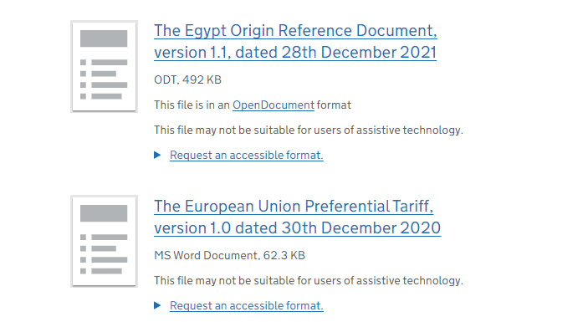
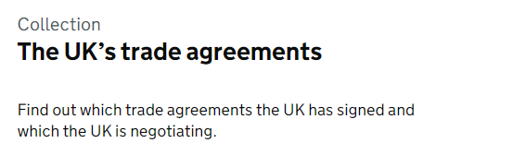
  TRADE AGREEMENTS
Trade agreements set out the rules that cover trade between 2 or more countries.
They aim to make trading easier between those countries. They do this by reducing the restrictions on imports and exports between them.
Companies will need to be aware of things such as rules of origin, reduced or zero-rate tariffs.
A list of the current UK agreements can be found here.
Reference documents for each agreement can be found here.

Slide 16
  TRADE AGREEMENTS
Whether your goods qualify as UK Preferential Origin will depend on the rules set out in the agreement, some rules include:
  Change of Tariff Classification
  Maximum Non-Originating Material Rules
  Specific Processes
  Regional Value Content, etc.
The evidence required will also vary based on the Trade Agreement and can include:
  EUR1 document
  Approved Exporter Status
  Statement of Origin on Commercial Invoice
  Etc.

Slide 17
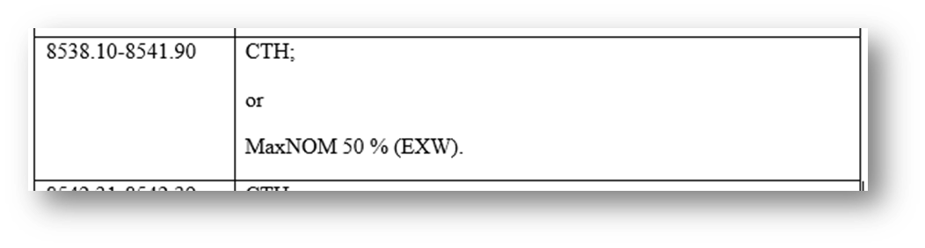
  TRADE AGREEMENTS – Example
For goods classified 8538100000, goods can only be of UK preferential origin as part of the FTA with the EU if:
•Items used to manufacture the final products were imported under a Chapter Heading other than 8538
•The value of the non-originating materials amount to maximum 50% of the EXW value of the goods.

Slide 18
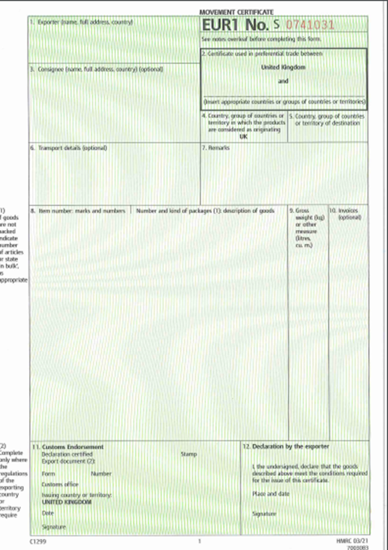
  EUR1
Preference documents, also known as “movement certificates”.
Currently accepted in about 70 countries around the world with Trade Agreement with the UK (Eg. Serbia, South Africa, Chile, etc.)
Evidence:
No evidence required to be provided to the Chamber of Commerce when applying. However, you must hold evidence in your files should these be requested by HMRC or foreign customs such as:
  Production Records (eg. Bill of Materials)
  Invoices from supplier/manufacturers
  Accounting Details
  Supplier's Declaration

Slide 19
  APPROVED EXPORTER STATUS
Approved Exporters must be authorised by HMRC and are entitled to self-declare the preferential origin of products by making out invoice/origin declarations on their invoices or another commercial documents.
This is only available in some trade agreements (Eg. South Korea and Chile).
Some agreements will allow an invoice declarations for shipments up to €6,000 / £5,200 or an EUR1 to claim preference if higher. In this case, an Approved Exporter would be allowed to do a self-declaration whatever the value of the shipment.
The application for Approved Exporter in the UK is here: https://www.gov.uk/government/publications/import-and-export-application-for-approved-exporter-status-c1454
The application must include:
  Country of Destination
  Commodity Code
  Information about the origin and evidence available

Slide 20
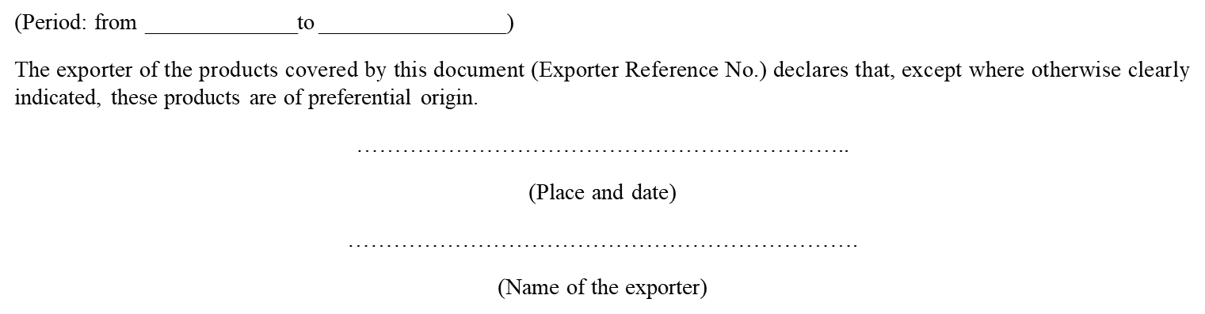
  INVOICE DECLARATION
In some trade agreements, traders can claim preferential origin through an invoice declaration (sometimes with a value threshold). The UK-EU TCA operates on this basis for shipments of all values.
By using the statement, you confirm that your goods qualify as preferential origin, and you hold evidence should this be requested.
The statement must comply with the requirements on the agreement. For the EU, the below template should be used:

Slide 21
5. QUESTIONS AND ANSWERS

Slide 22

Trading with the World & Session Poll
Tell us how you’re finding trading with EU and Non-EU countries

Slide 23
6. UPCOMING SESSIONS

Slide 24

SESSIONS COMING UP
25 APR
AID FUNDED BUSINESS OPPORTUNITIES FOR BRITISH COMPANIES
29 APR
COMMON USER CHARGES & BTOM LATEST UPDATES
15 MAY
TRADING WITH EGYPT - TO BE CONFIRMED
Register Now with your Local Chamber!

Slide 25
THANK YOU
We look forward to working with you

Slide 26










Contact your local chamber for further support

